Slide 1
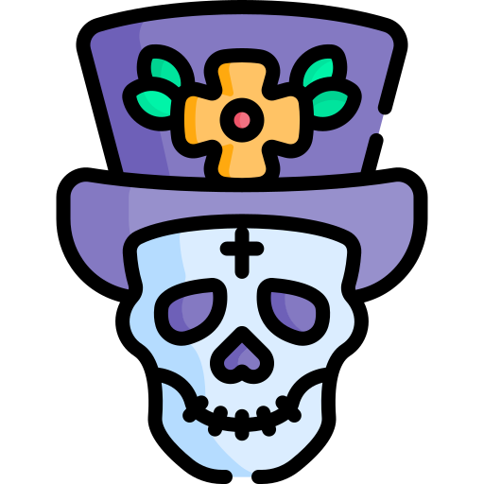
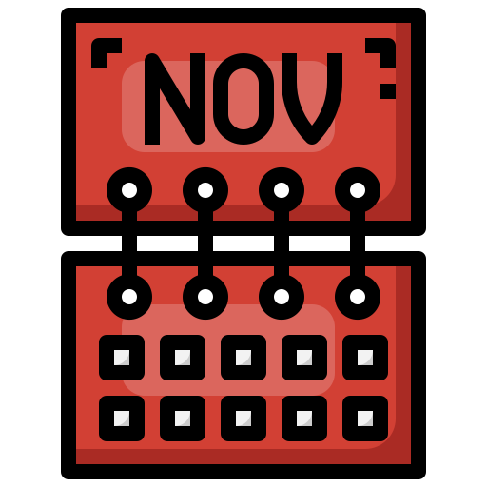
CompSci club
Dictionary Methods
This should help you with your project!

Slide 2

Our person of the day!
Robert Tappan Morris
On November 2nd, 1988, Robert Tappan Morris, then a graduate student at Cornell University, made a bit of a mistake
In an effort to see if a computer worm could be made, Morris deployed a computer worm that would exploit weak passwords
He deployed the worm at MIT, hoping that the creator would be thought to study there
His worm targeted Unix systems, an operating system his father help make
Morris’s goal wasn’t to create something destructive, he simply wanted to show the weaknesses of networks at the time
It turned costly thought when Morris included a feature that would duplicate the worm 14% of the time regardless of previous infection status
The worm caused $100,000 to $10,000,000 in damage, and reportedly infected 2,000 computers in 15 hours
Morris was put 3 years on probation, with 400 hours of community service and a $13,000 fine
Creator of the first Computer worm

Slide 3



Roadmap for Today
Random Module
This is a commonly used library that we didn’t cover last week
Dictionary Methods
A deeper look at dictionaries!
Dictionary Practice
Some hands-on practice with dictionaries!

Slide 4
Randomness is a surprisingly commonly used part of programming!
A look at the
Random Module

Slide 5
Random Module
import random as rand
elements = ["Water", "Fire", "Air", "Earth"]
print(rand.random()) #0.8341936011525182
print(rand.randint(1,11)) #5
print(rand.choice(elements)) #Air
The random module is one of the built-in packages into Python, and provides a lot of useful methods and functions that are centered around randomness
We will most likely use this later in the year, so here are some common methods!
rand.random() - Generates a random float between 0 and 1
rand.randint(a,b) - Generates a random integer between a and b+1
rand.choice(seq) - Picks a random element from a sequence (like a list)
rand.shuffle(seq) - Randomly shuffles up a list (modifies the list directly)
rand.sample(population, k) - Takes k amount of elements from the population without replacement
The random docs are a great place to learn more!
import random as rand
friends = ["Bob", "Elmo", "Cookie Monster", "Clifford", "Caillou"]
rand.shuffle(friends)
print(friends) #['Clifford', 'Cookie Monster', 'Caillou', 'Elmo', 'Bob']
Notes:
Want to know the difference between rand.choices and rand.sample? Check out this post! https://stackoverflow.com/a/59763969

Slide 6
Randomness is a surprisingly commonly used part of programming!
Let’s explore
Dictionary methods

Slide 7
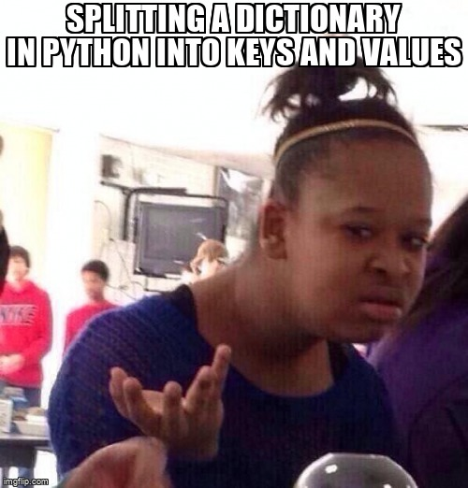
Dictionaries
...no not Webster dictionaries

Slide 8
What are dictionaries? Components / Basics
“Dictionaries are used to store data values in key:value pairs.
A dictionary is a collection which is ordered*, changeable and does not allow duplicates.”
Which means that they are mutable!
So…
If you have a key you can access the word, term, number, list, etc
(anything that you want to put in the value)
But this also means that you cannot have the same key for two different values (see next slide)
Example: (Making a dictionary..this code should print out “Ford”)
thisdict = {
"brand": "Ford",
"model": "Mustang",
"year": 1964
}
print(thisdict["brand"])

Slide 9
What on Earth would this code print...
thisdict = {
"brand": "Ford",
"model": "Mustang",
"year": 1964,
"year": 2020
}
print(thisdict)

Slide 10
To see the number of items in a dictionary you can use the following code (note this code is when your dictionary is named “thisdict”)
print(len(thisdict))
To see what type of object are in your dictionary you can use…
thisdict = {
"brand": "Ford",
"model": "Mustang",
"year": 1964
}
print(type(thisdict)) ← this is the line that actually does what you want

Slide 11
ARE YOU CONFUSED? Here’s what differentiates everything...
List is a collection which is ordered and changeable. Allows duplicate members.
Tuple is a collection which is ordered and unchangeable. Allows duplicate members.
Set is a collection which is unordered, unchangeable, and unindexed. No duplicate members.
Dictionary is a collection which is ordered and changeable. No duplicate members.

Slide 12
Project wise:
Let’s talk about how to code the biggest part of the program!
We will reason through it together and will come up with ideas for the architecture of the program as well as the algorithm that will we the basis of the whole program in general.
Let's look at how we are going to put multiple “things” into a single value of a key:value pair! Can anyone tell me why we need to even do this?

